Slide 1
WELCOME TO OUR
CLASS:4/1
TEACHER: Ho Lam Tuyen

Slide 3
DAYS
OF
THE
WEEK

Slide 4
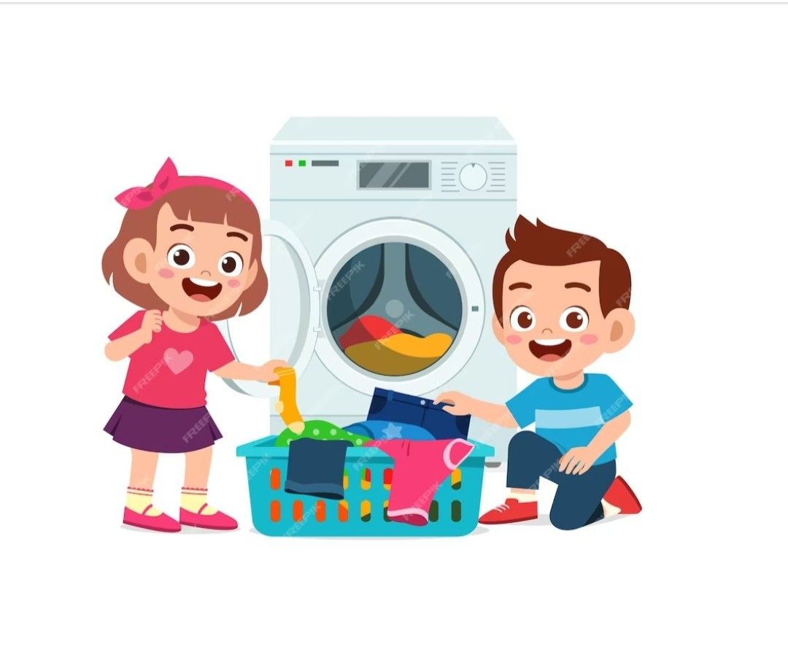
What do you do in the morning?
I wash the clothes.

Slide 5
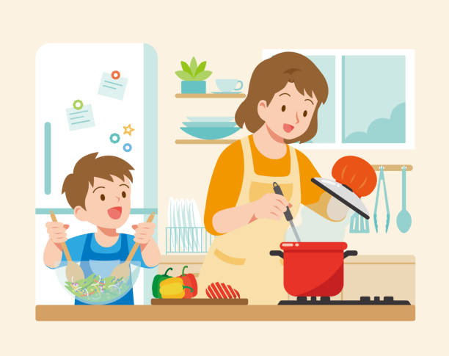
What do you do in the evening?
I help with the cooking.

Slide 6
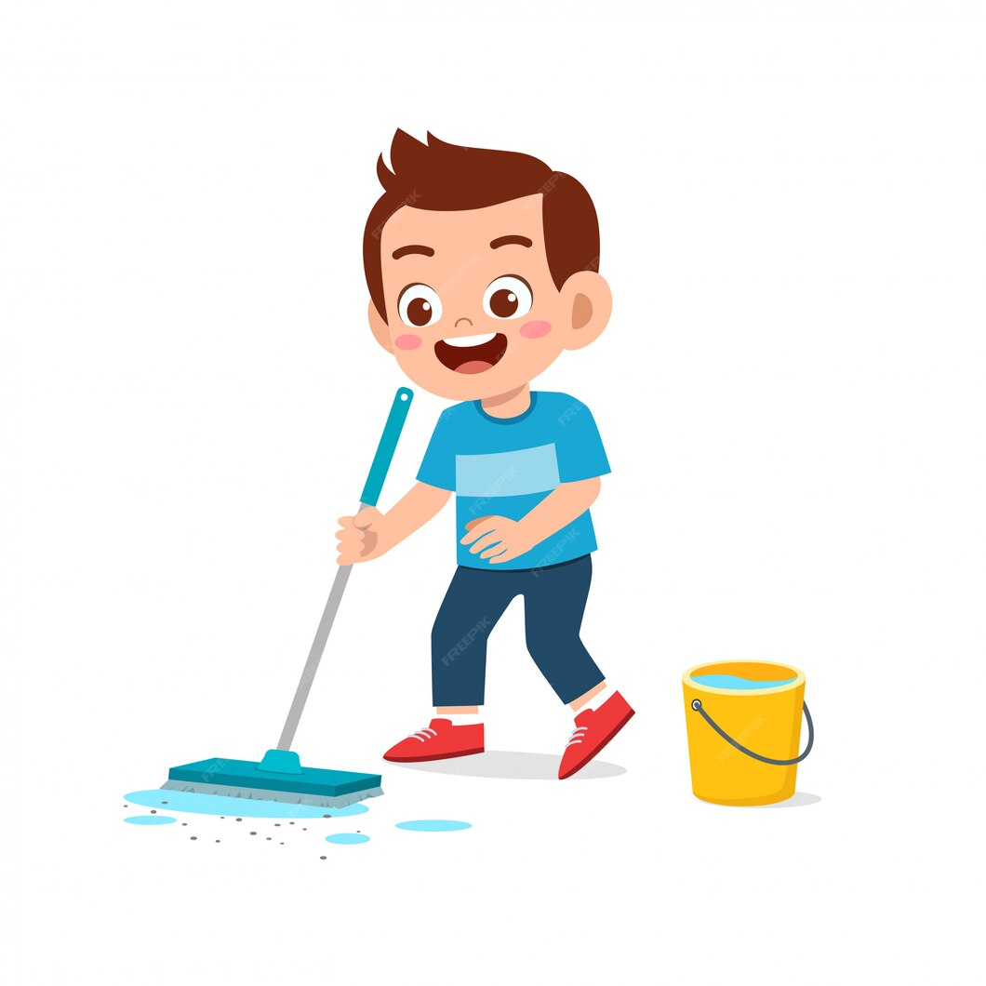
What do you do in the afternoon?
I clean the floor.

Slide 7
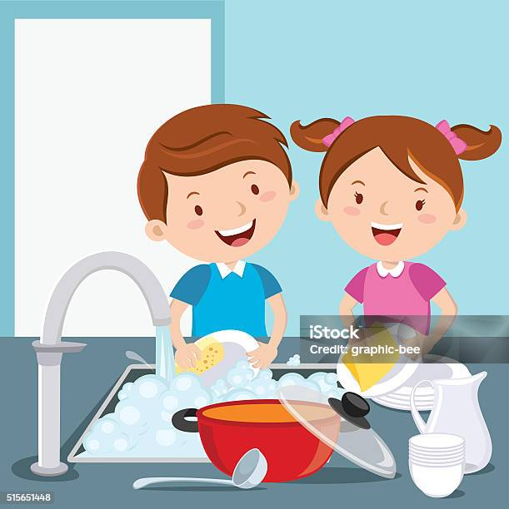
What do you do in the afternoon?
I wash the dishes.

Slide 8
WEEKEND

Slide 9
s.

Slide 10
Where does he go on + (thứ trong tuần)?
(Anh ấy đi đâu vào ….?)
→He goes to the + nơi chốn.
(Anh ấy đi đến ….)
Ex: Where does he go on Saturdays?
→ He goes to the cinema.
Where does she go on + (thứ trong tuần)?
(Chị ấy đi đâu vào ….?)
→She goes to the + nơi chốn.
(Anh ấy đi đến ….)
Ex: Where does she go on Saturdays?
→ She goes to the cinema.

Slide 12
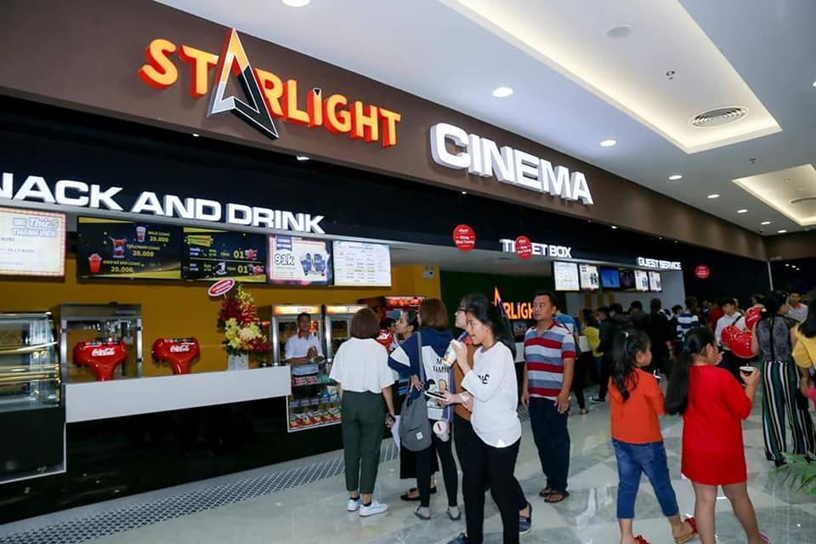
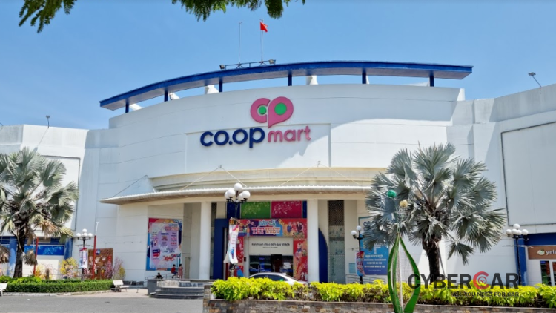
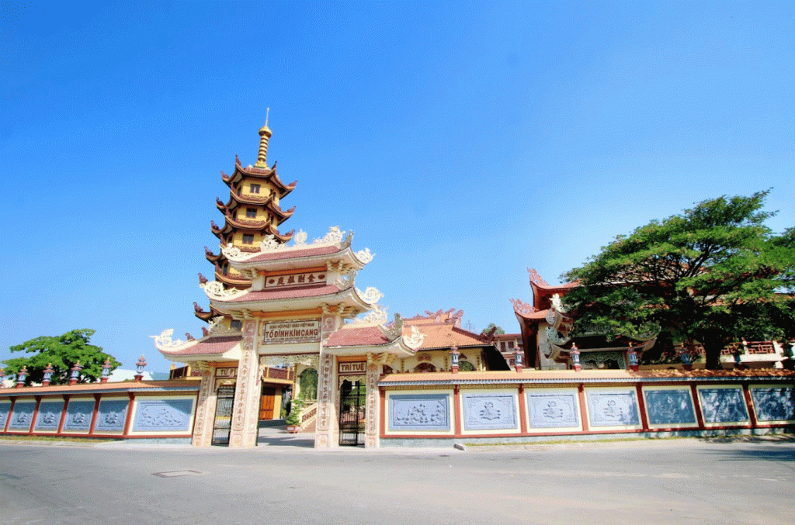
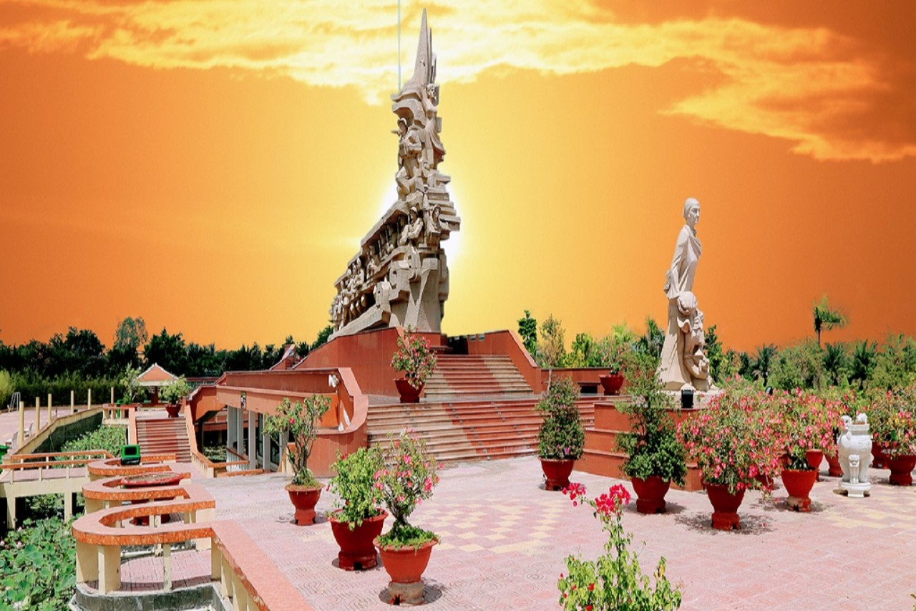
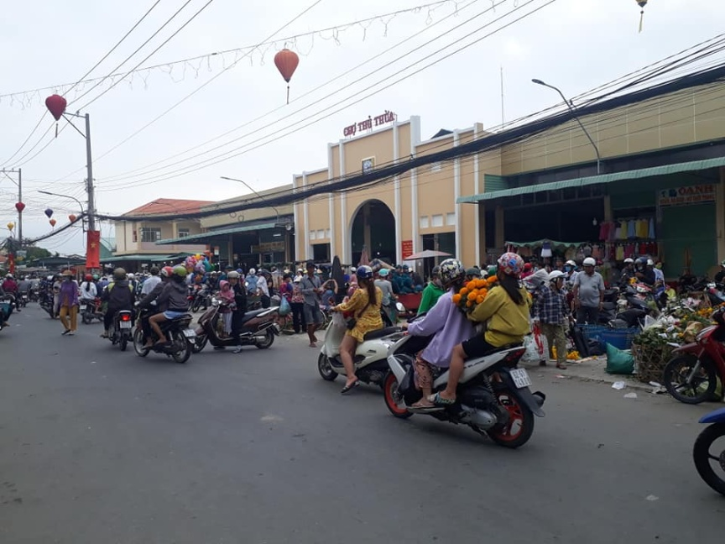
At the weekend, my father goes to the……………….
My mother goes to the ………………. And I go to the …………………………

