Slide 1

WELCOME TO OUR CLASS
CLASS 4/5

Slide 2
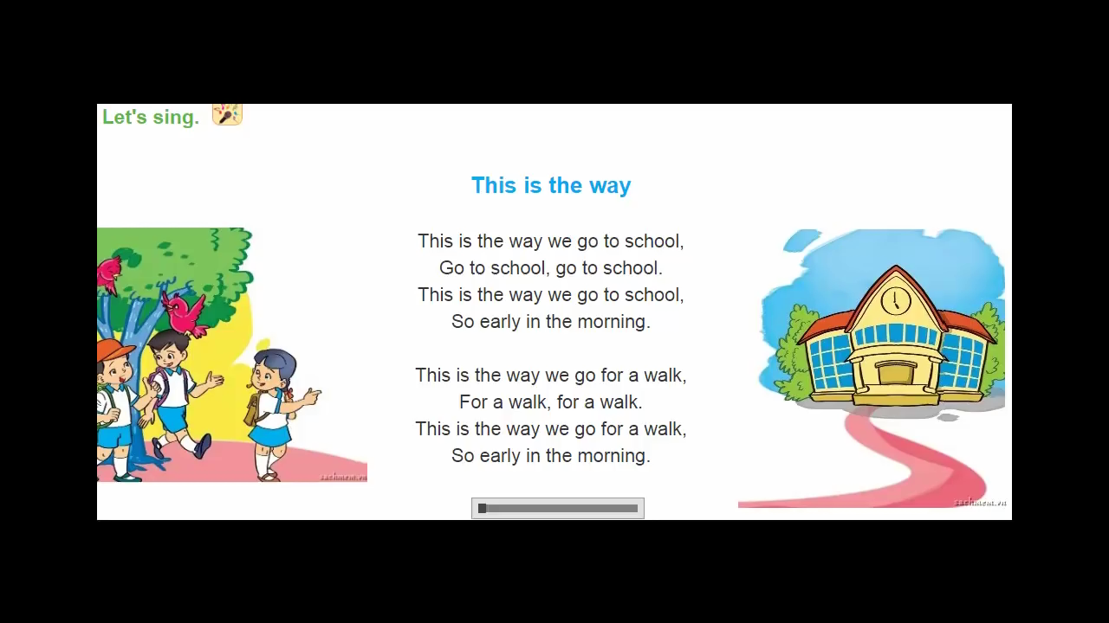


Slide 3
Warm-up
Choose the best answer

Slide 4
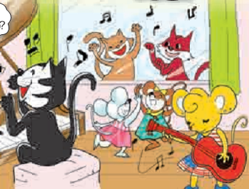
1.Where is Mary from?
Vietnam
America
England

Slide 5
2.What can Mary do?
Play the guitar
Play chess
Play football

Slide 6
3.What can Miu do?
Play the guitar
Play the piano
Play football

Slide 7
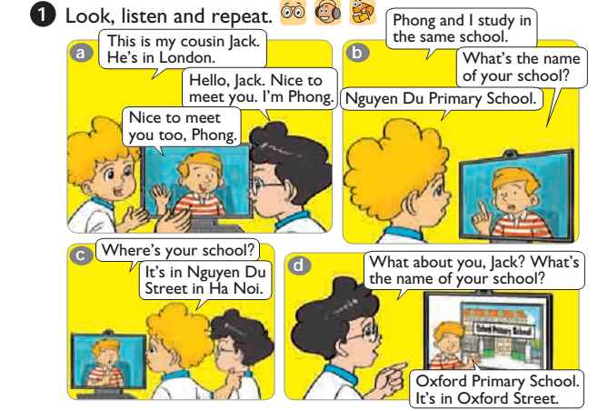


Slide 8


Thursday, November 4th 2022
Unit 6: Where’s your school?
Lesson 1- (1,2)

Slide 9
I. New words
cousin:
anh, chị, em họ

Slide 10

I. New words
road :
đường

Slide 11

street :
phố, đường phố

Slide 12

village :
làng

Slide 13

district :
quận, huyện

Slide 14

study :
học

Slide 15
Vocabulary
cousin road street village district study | anh, chị, em họ đường phố làng, xã quận,huyện học

Slide 16
Matching:
Road Street Village District study | học Quận, huyện Phố, đường phố Đường làng

Slide 18
II. Structures
Ex: Where’s your school ?
It’s in Nguyen Du Street in Hanoi
Hỏi và trả lời về địa điểm của trường học
Where’s your school?
(Trường của bạn ở đâu?)
It’s in + (name) street/ road/village, district .

Slide 19
Where’s your school?
-> It’s in
Tran Phu street
Đường (phố) Trần Phú

Slide 20
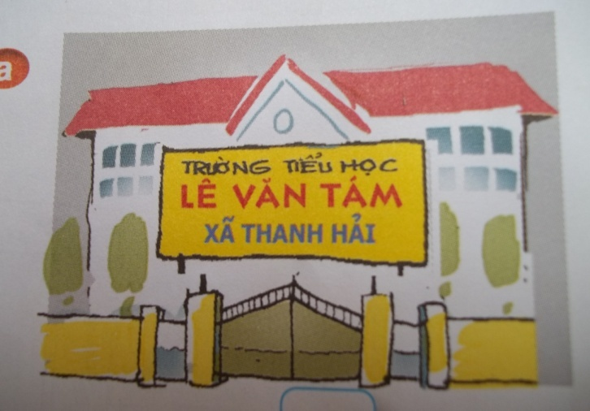

Where’s your school?
Thanh Hai Village
It’s in.......................

Slide 21
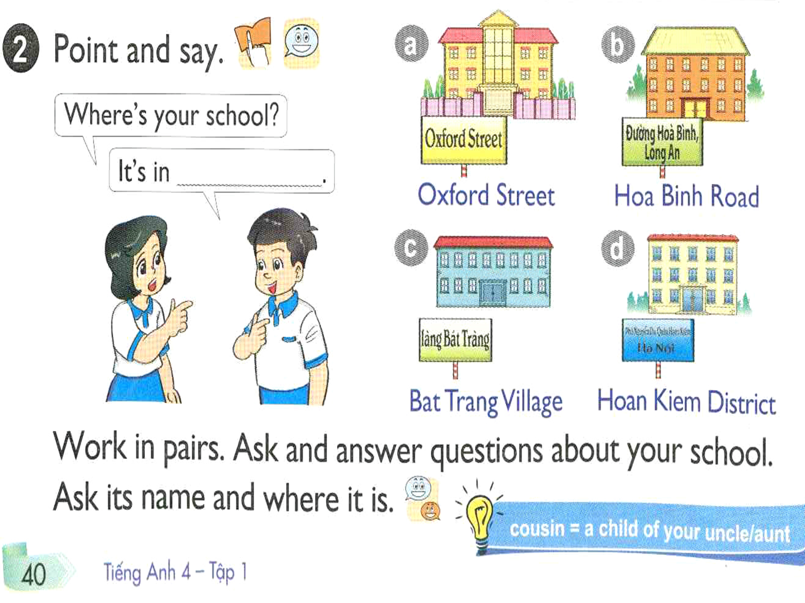

Slide 22
Ask and answer in pairs
What is the name of your school?
Where is your school?
It’s Binh Thanh Primary School
It’s in Binh Thanh Village

Slide 23

III. Homework
- Learn by heart the vocabulary.
Practise the sentence pattern.
Prepare Unit 6: lesson 2.

Slide 24

Thank you
Good bye!

