Slide 1
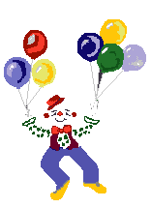
Welcome to our class 5
Teacher: HO LAM TUYEN
BINH THANH Primary School

Slide 2
Revision

Slide 4
UNSCAMBLE WORDS
dilayoh
holiday
cheab
beach
stamounin
mountains
ldissan
islands

Slide 5
Wednesday, November 8th ,2023.
Unit 6: How many lessons do you have today?
Lesson 1(1,2,3)

Slide 6
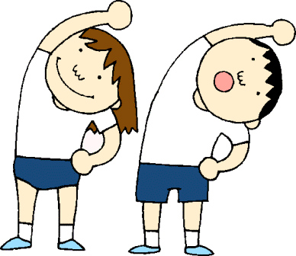
* Vocabulary:

Slide 7
Maths

Slide 8
Art

Slide 9
Music

Slide 10
Vietnamese

Slide 11
PE
(Physical Education)

Slide 12
English

Slide 13
IT
(Information Technology)

Slide 14
Science

Slide 15
* Vocabulary:

Slide 16
Structure:
How many lessons do you have today?
→ I have ……: ……….....

Slide 17
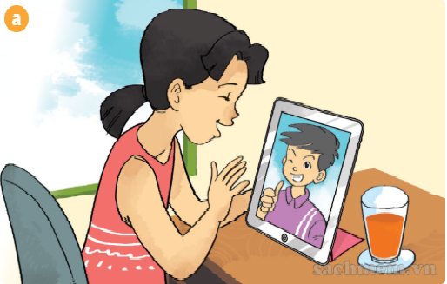
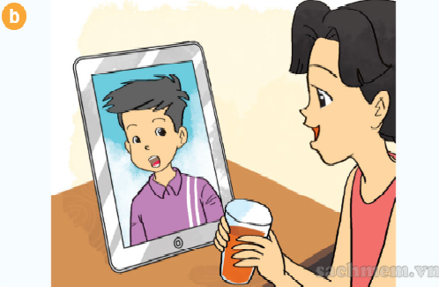
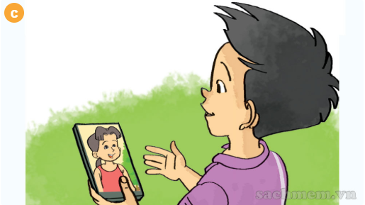
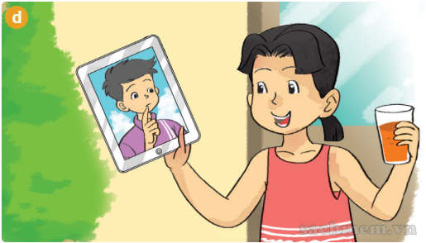

Slide 18
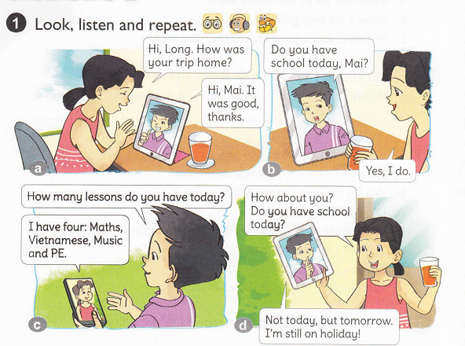

Slide 19
Hi, Long. How was your trip home?
Hi, Mai. It was good, thanks.

Slide 20
Do you have school today, Mai?
Yes, I do.

Slide 21
How many lessons do you have today?
I have four: Maths, Vietnamese, Music and PE.

Slide 22
How about you?
Do you have school today?
Not today, but tomorrow. I’m still on holiday.

Slide 23
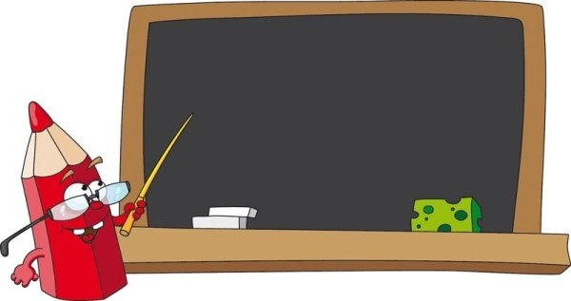
How many lessons do you have today?
Monday
→ I have …….: ……...
Music
✓
Maths
✓
PE
✓

Slide 24
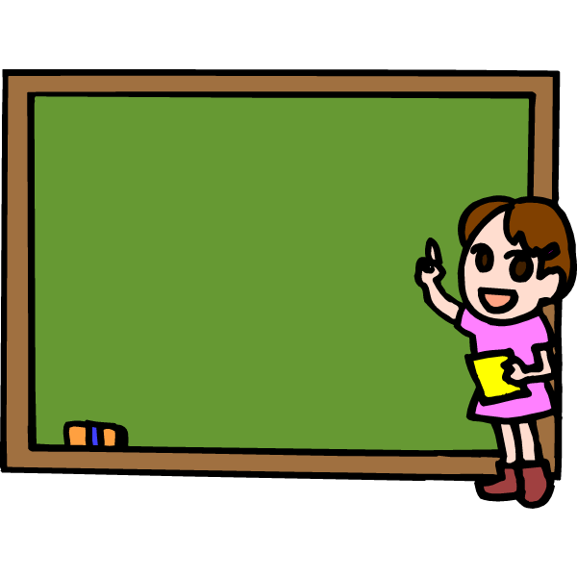
How many lessons do you have today?
Tuesday
→ I have ……: ………………….
Vietnamese
✓
English
✓
Art
✓
IT
✓

Slide 25
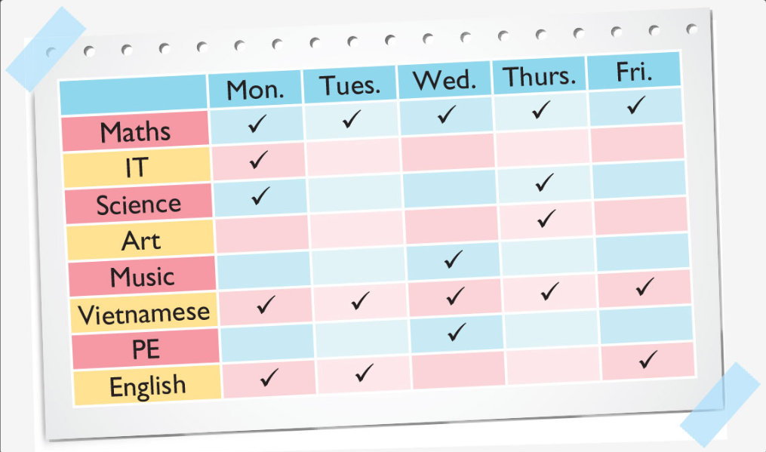
2. POINT AND SAY:
How many lessons do you have today?
→ I have ……: …………...
3
4
4
3
5

Slide 26
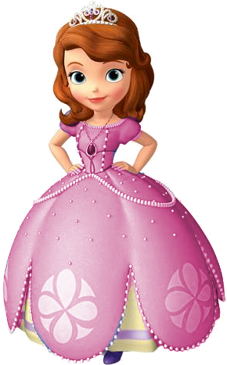
Lucky stars

Slide 27
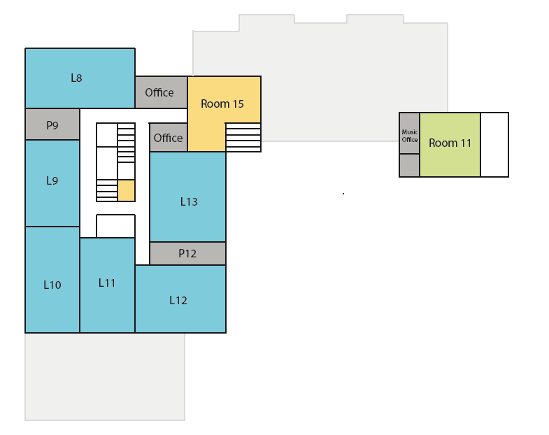
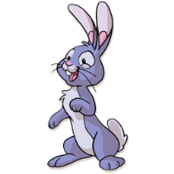
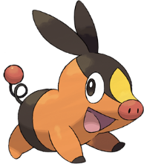
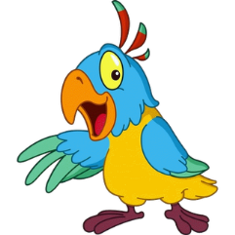

Slide 28
Thursday
Vietnamese
✓
English
✓
Science
✓

Slide 29
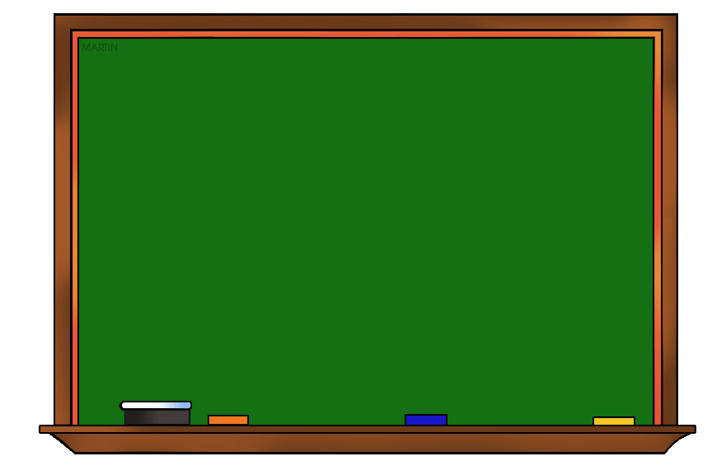
Monday
✓
Maths
Vietnamese
✓
IT
✓
English
✓
Science
✓

Slide 30
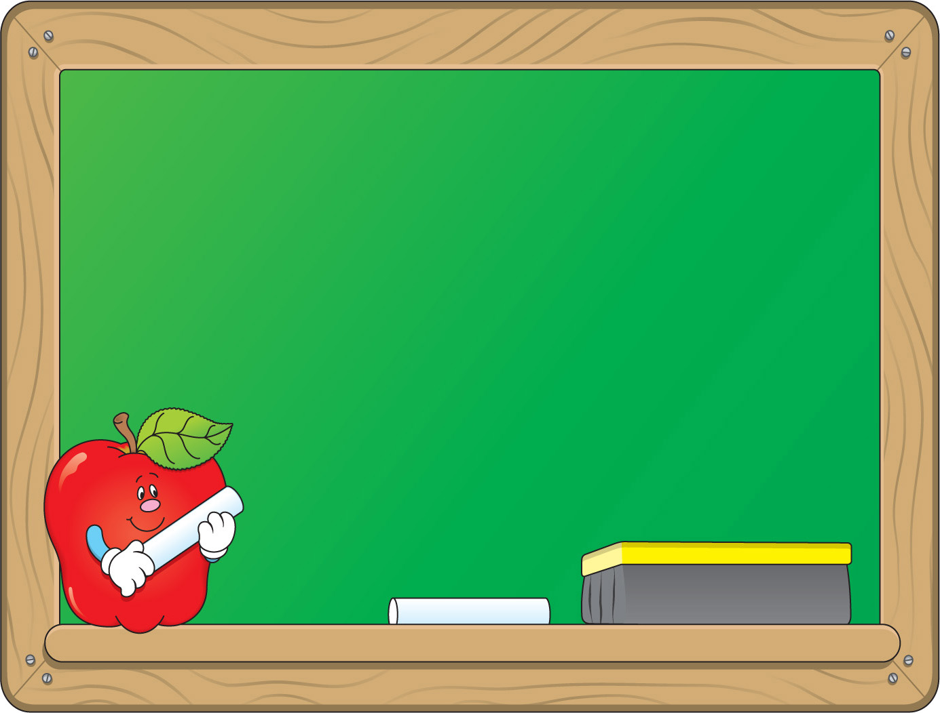
Friday
Music
✓
Art
✓
PE
✓

Slide 31
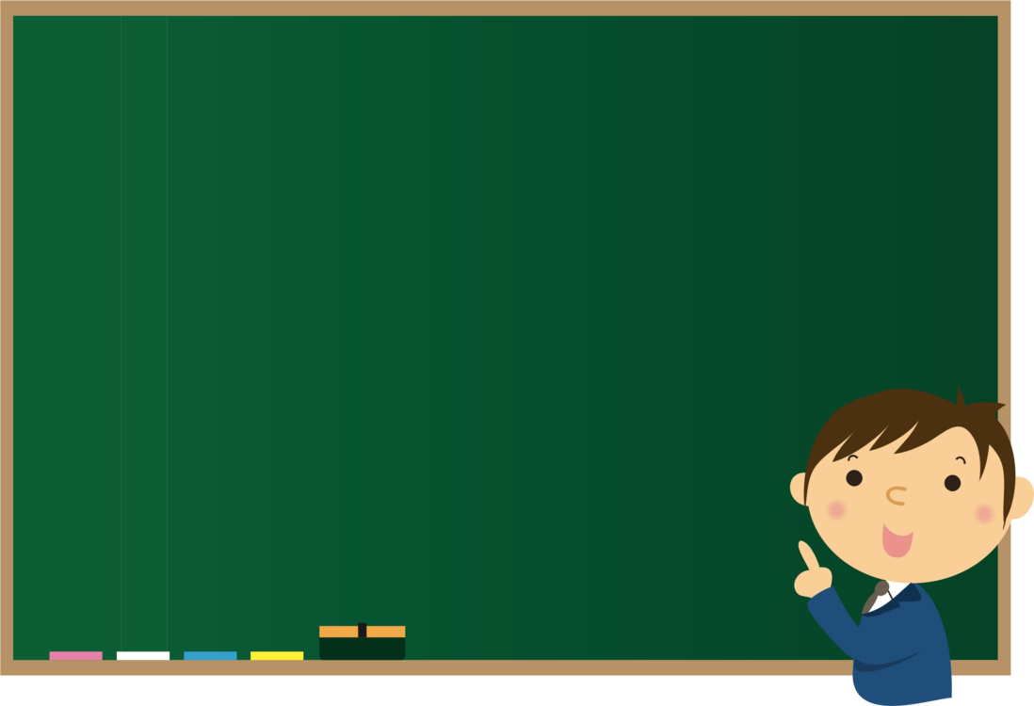
Wednesday
Vietnamese
✓
Maths
✓
English
✓

Slide 32
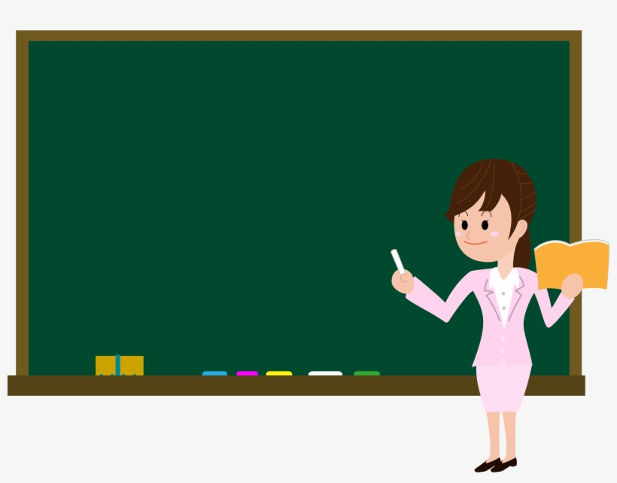
Tuesday
IT
✓
Music
✓
Art
✓
Vietnamese
✓

Slide 33
Friday
Vietnames e
✓
Maths
✓
Music
✓

Slide 34
How many lessons do you have today?
I have …..: …………….

